Slide 1
Vehicle detection using faster r-cnn
By
Prakhar dogra
Yogen chaudhari

Slide 2
Dataset and Objective
MIO-TCD (MIOvision Traffic Camera Dataset)
Contains 110k images with ground truth labels (bounding boxes). 90k were used for training and validation. 20k were used for testing.
Using this data our objective was to understand and use a state-of-the-art architecture to train a model that can detect vehicles.
Detecting a vehicle basically means localizing the vehicle using bounding boxes and classifying it.

Slide 3

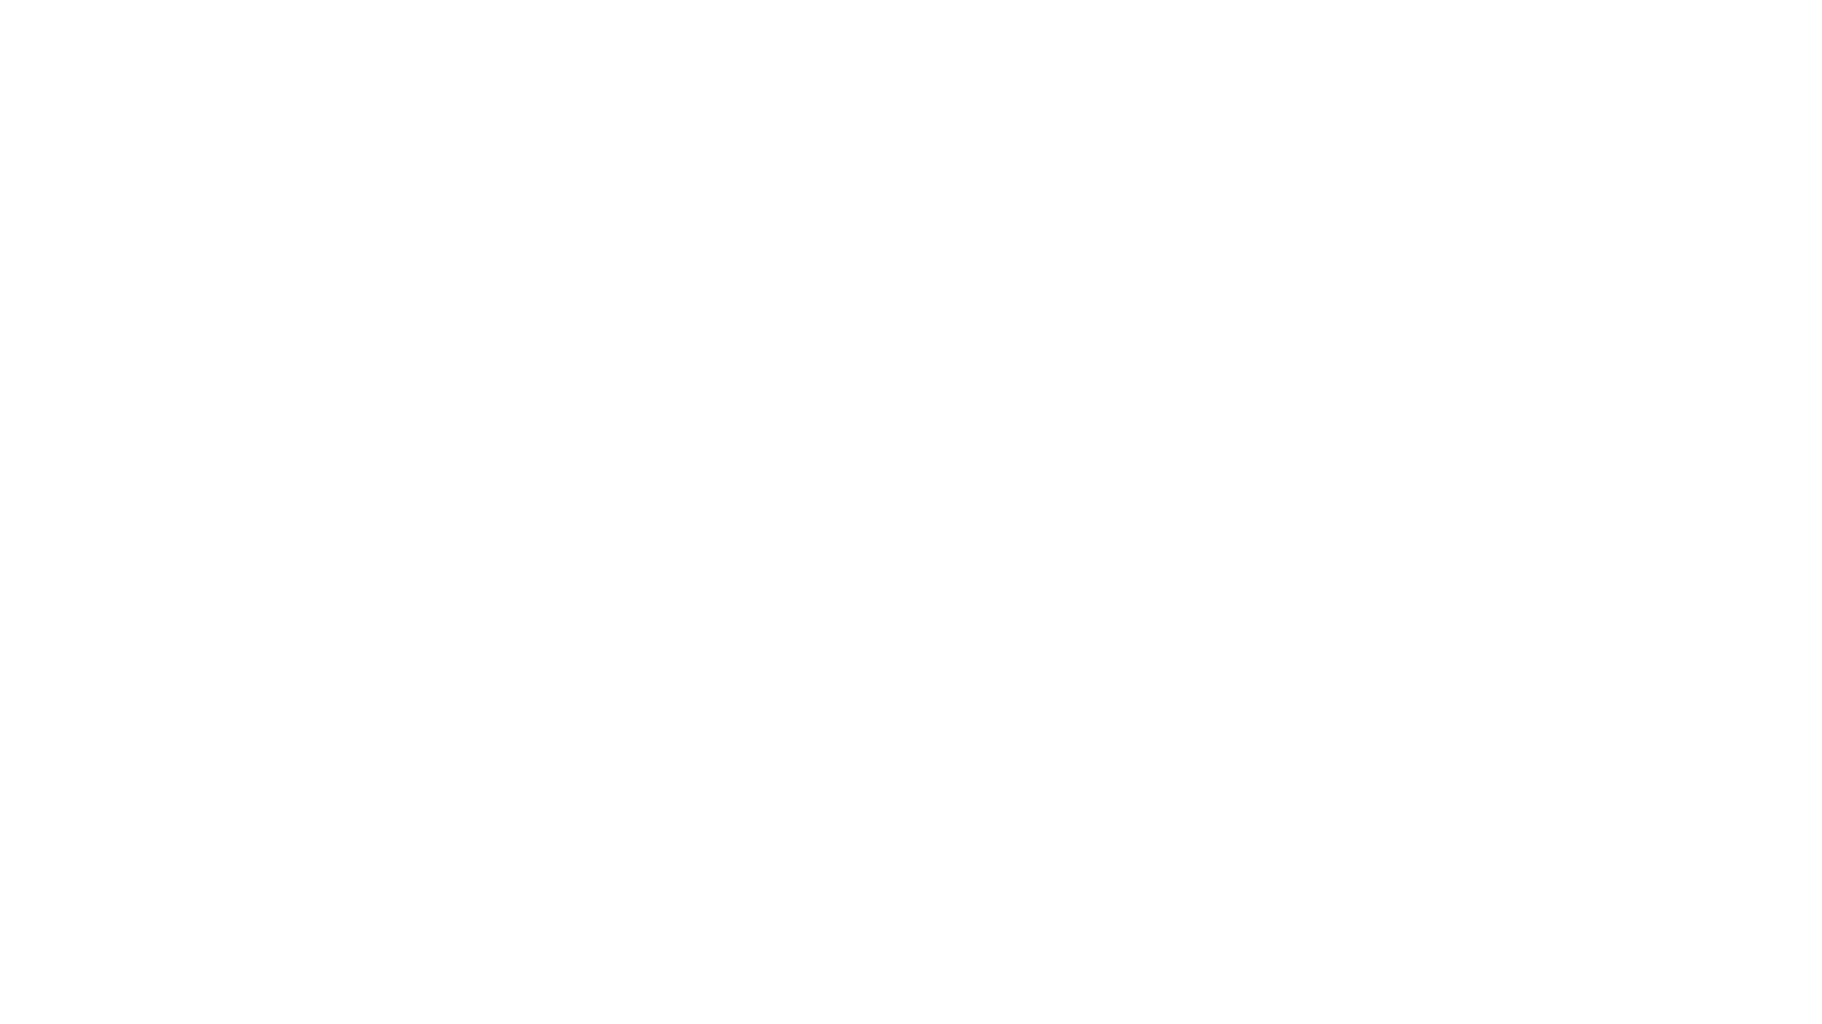
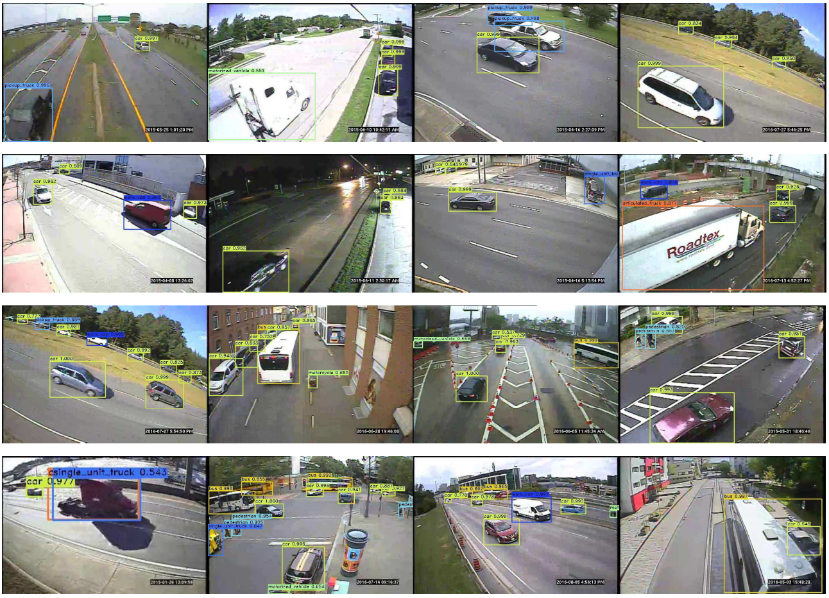
SOMETHING LIKE THIS…

Slide 4
SOME PREREQUISITE KNOWLEDGE
Convolutional Neural Networks
VGG and ResNet architectures
R-CNN
Fast R-CNN (ROI Pooling)
Intersection over Union
Anchors
Non-Maximum Suppression
Data Augmentation

Slide 5
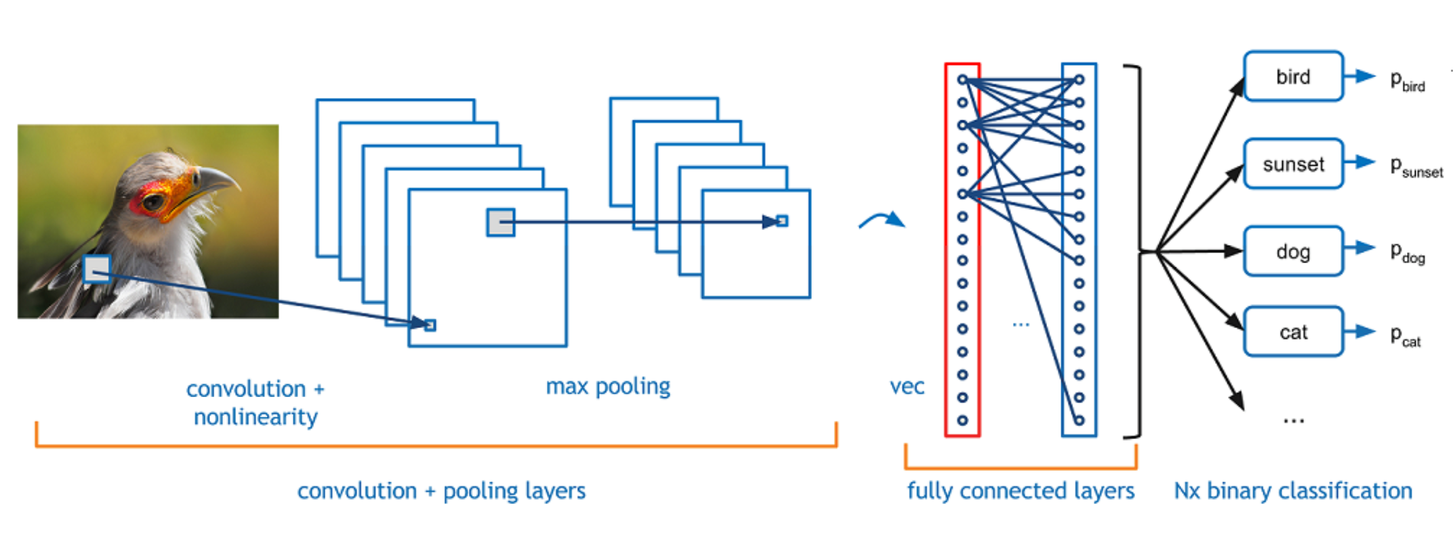
Convolutional neural networks

Slide 6

VGG architecture

Slide 7
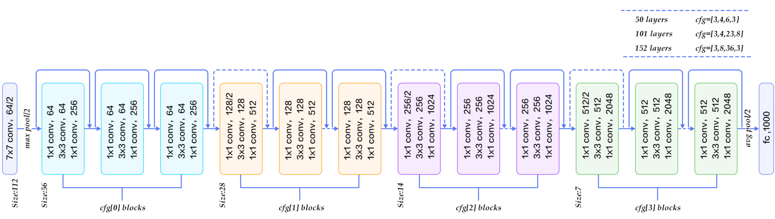
Resnet architecture

Slide 8
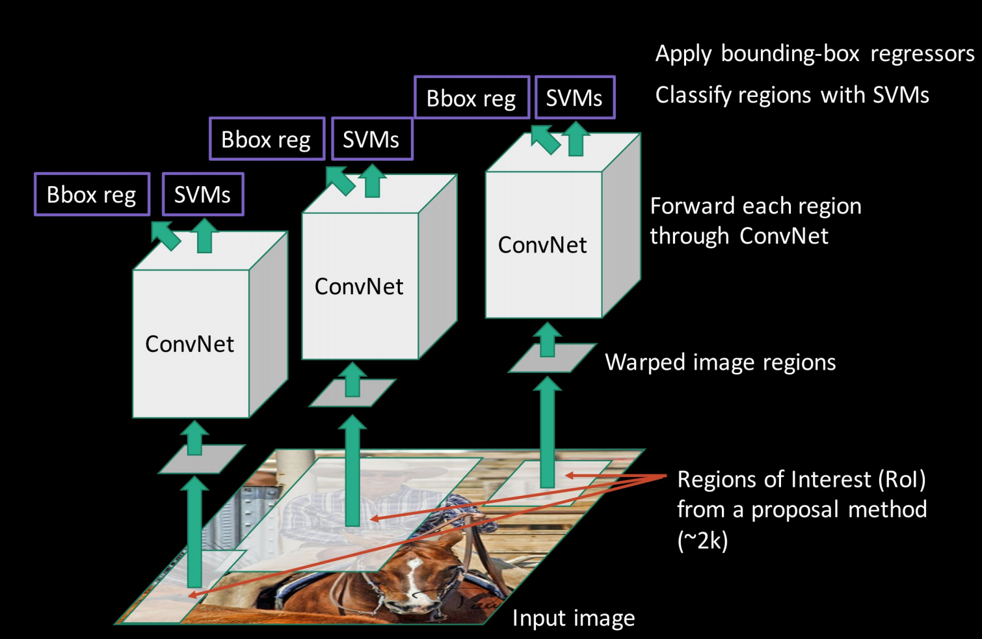
Region based cnn

Slide 9
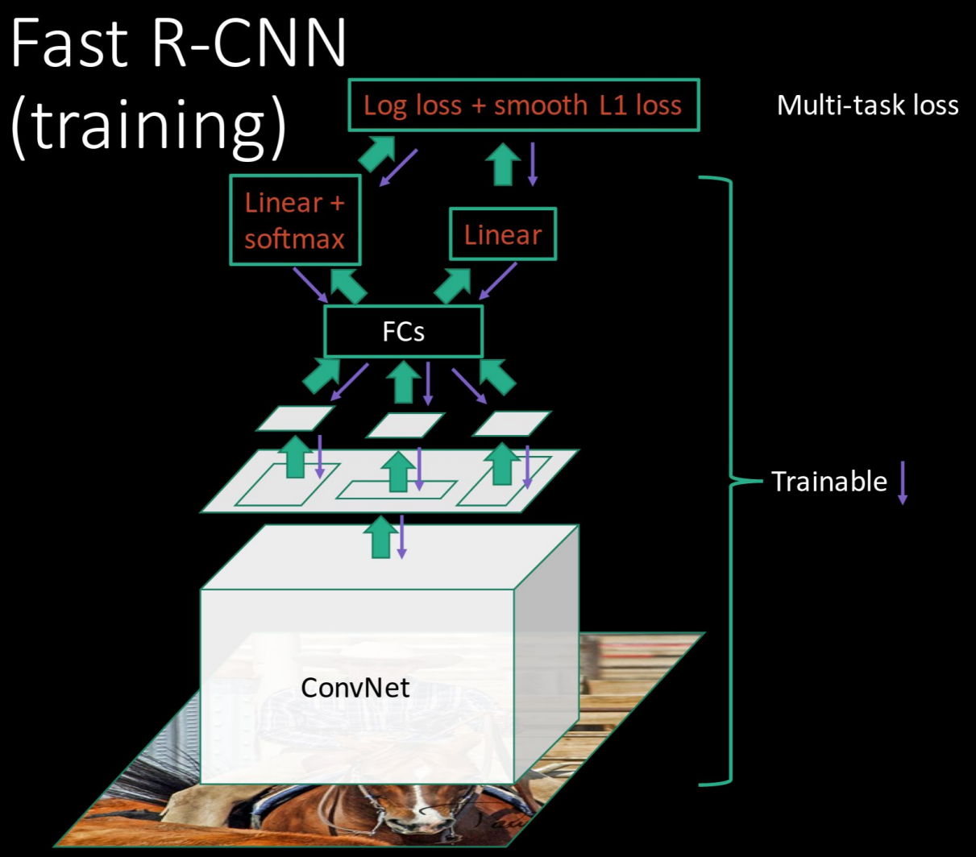
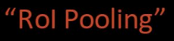
Fast r-cnn

Slide 10
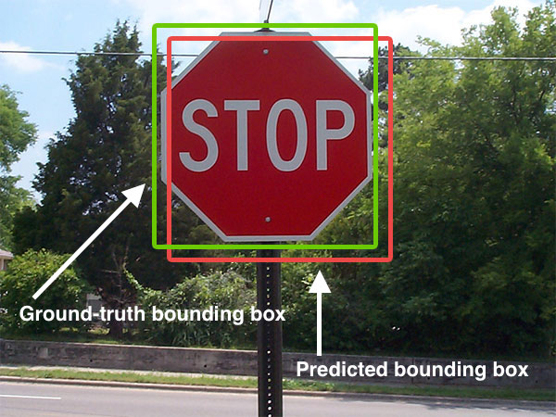
Intersection over union
Intersection over Union is an evaluation metric used to measure the accuracy of an object detector
IOU = (Area of Intersection) /(Area of union)

Slide 11
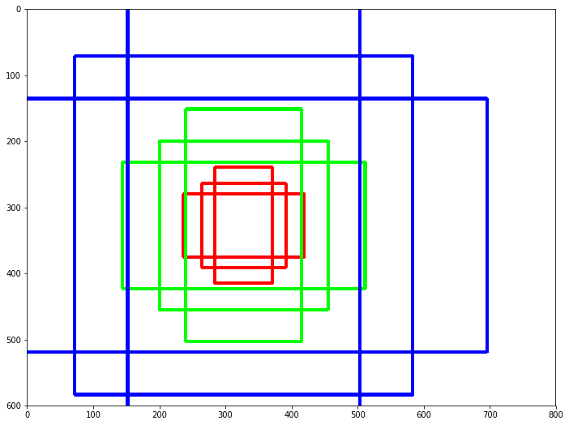
anchors
Anchors are sliding windows with different scales and aspects ratios.
In Faster R-CNN they become our initial region proposals.
For each anchor we have a six tuple (p1, p2, x1, y1, x2, y2)

Slide 12
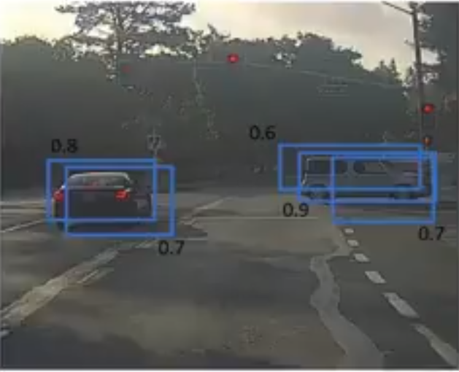
Non-Maximum suppression
Non-maximum suppression takes the list of proposals sorted by score, discarding those proposals that have an IoU larger than some predefined threshold with a proposal that has a higher score.

Slide 13
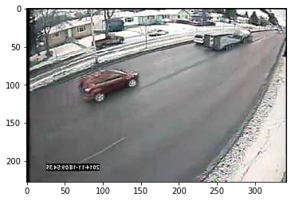
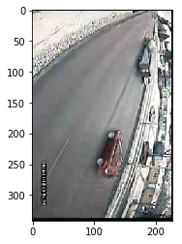
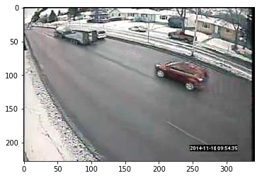
Data augmentation
Data augmentation is one of the techniques mostly used to improve the performance of computer vision systems.
Generating rotated or flipped instances of data helps cover various scenarios.

Slide 14
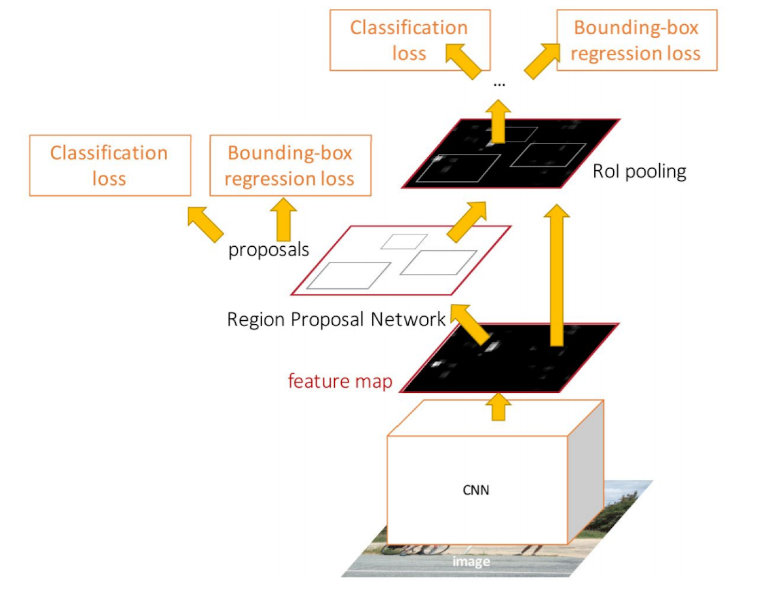
Faster r-cnn architecture
Pre-train a CNN network
Fine-tune the RPN (region proposal network) end-to-end for the region proposal task, which is initialized by the pre-train image classifier.
Train a Fast R-CNN object detection model using the proposals generated by the current RPN

Slide 15
Results (Mean average precision scores)
Architecture Data Augmentation | VGG | ResNet
Without Augmentation | 0.443 | 0.451
With Augmentation | 0.527 | 0.560

Slide 16
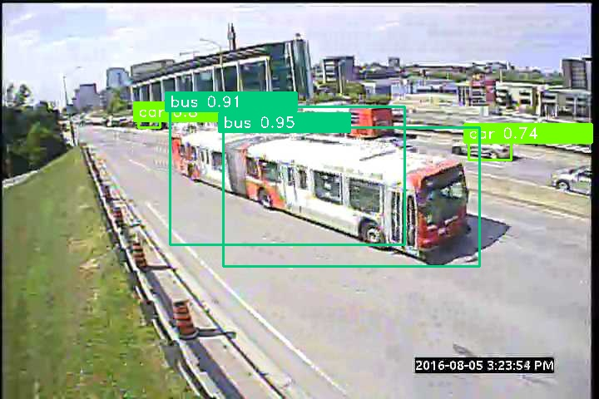
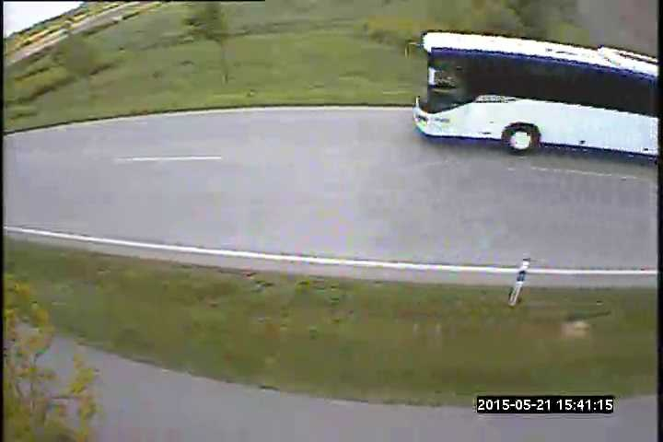
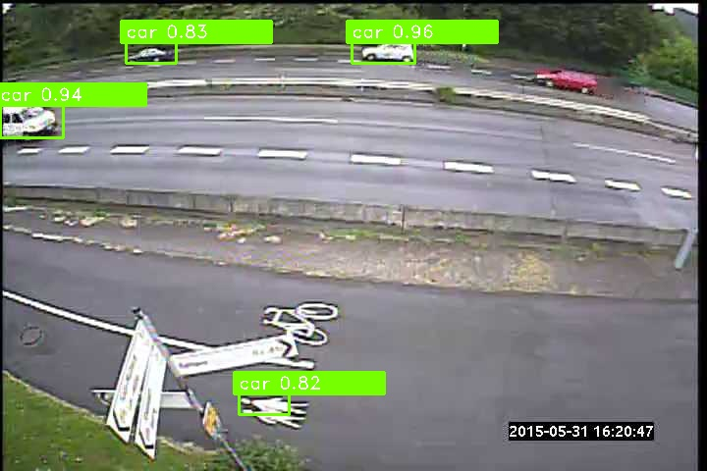
Bad results
Overlapping boxes
UNABLE TO DETECT
INCORRECT DETECTION

Slide 17
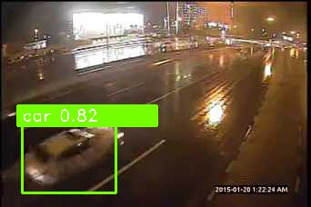
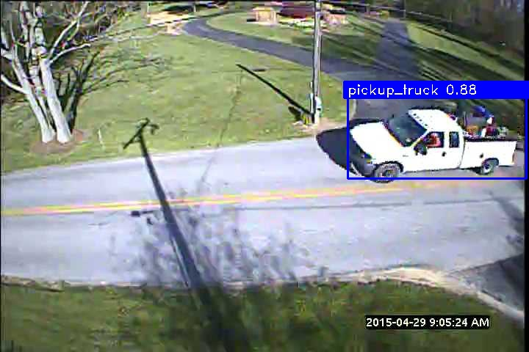
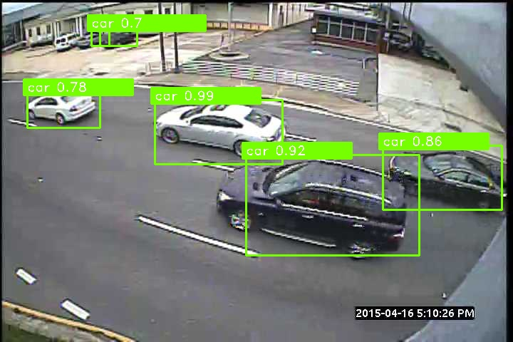
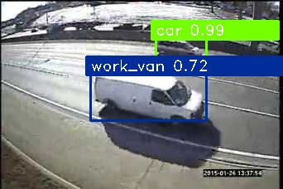
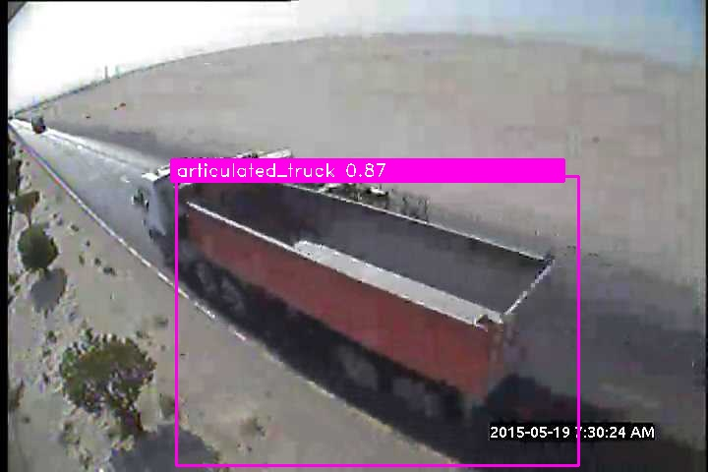
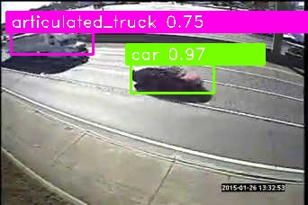
Good results

Slide 18
Future work
Try different architectures:
Mask R-CNN
RFCN (Region based Fully Connected Network)
YOLO (You Only Look Once)
SSD (Single Shot Detection)

Slide 19
REFERENCES
https://arxiv.org/pdf/1311.2524.pdf (Rich Feature Hierarchies for Accurate Object Detection and Semantic Segmentation)
https://arxiv.org/pdf/1504.08083.pdf (Fast R-CNN)
Dataset: http://tcd.miovision.com/challenge/dataset/
https://arxiv.org/pdf/1506.01497.pdf (Faster R-CNN: Towards Real-Time Object Detection with Region Proposal Networks)
http://cs231n.stanford.edu/slides/2017/cs231n_2017_lecture11.pdf (Lecture Slides 11: Detection and Segmentation)

